Slide 1


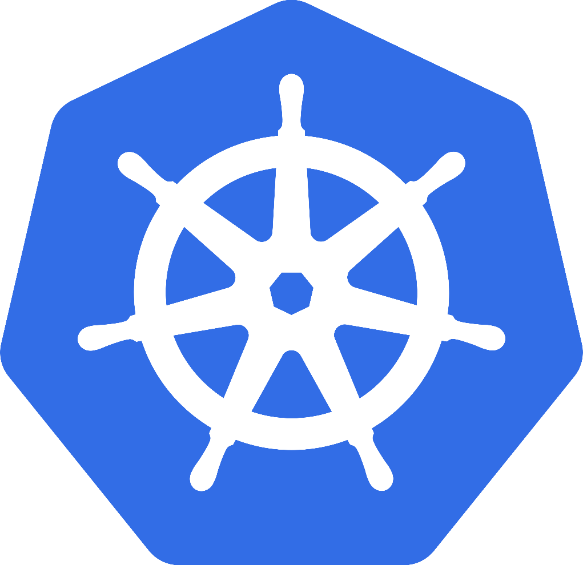

Presented by:
MA067
TANK RAJNIKUMAR
MA075
VALAKI JAYMIN

Slide 2
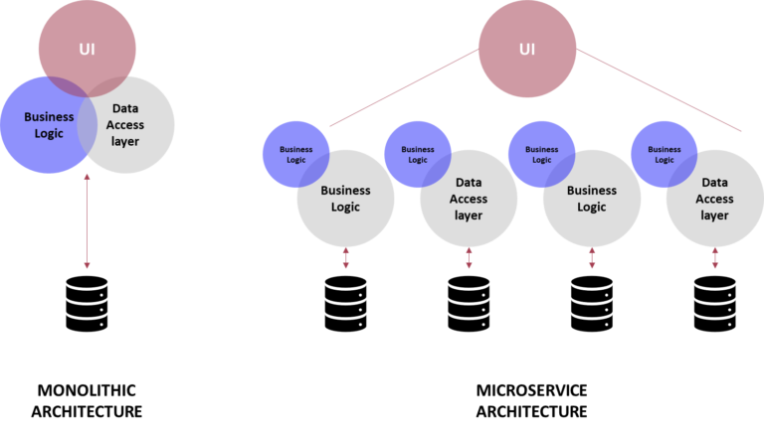
ARCHITECHURE & IT’s TYPES
The architecture reflects how the system application is used and how it interacts with other systems and the outside world.
TYPES OF ARCHITECHURE
1)MONOLYTH ARCHITECHURE
2)MULTI SERVICE ARCHITECHURE

Slide 3
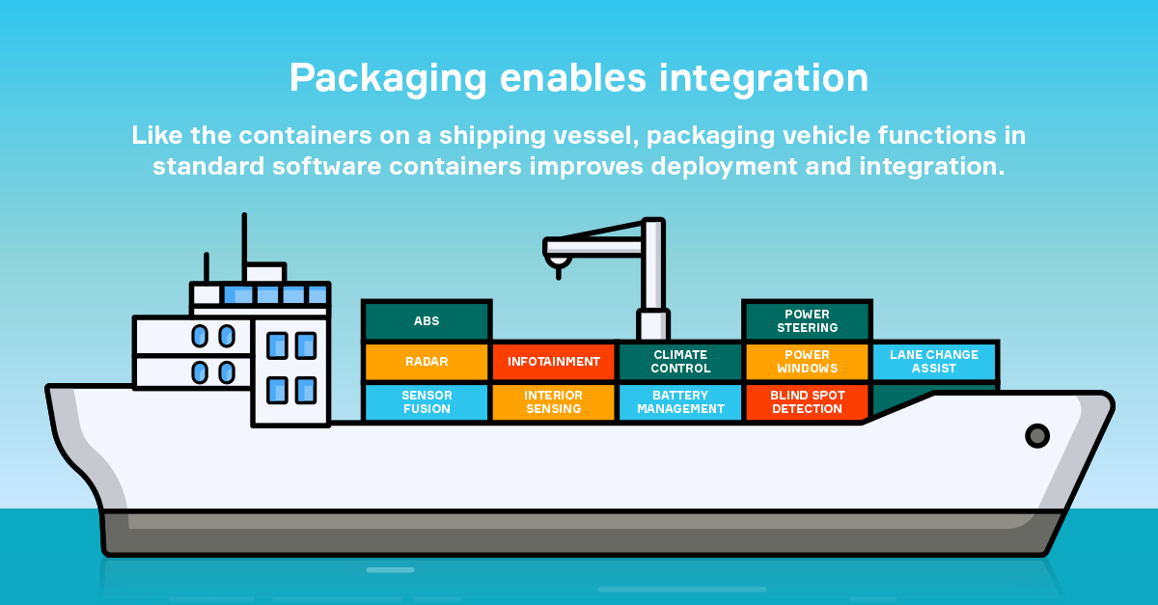
CONTAINERIZATION
What are the containers ?
Containerization is like putting an app and all its stuff in a nice little box. This box is called a container, and it has everything the app needs to work.
It's like a self-contained package that can run on any computer, no matter where it is.
Necessary executables binary
code libraries and
configuration files.

Slide 4
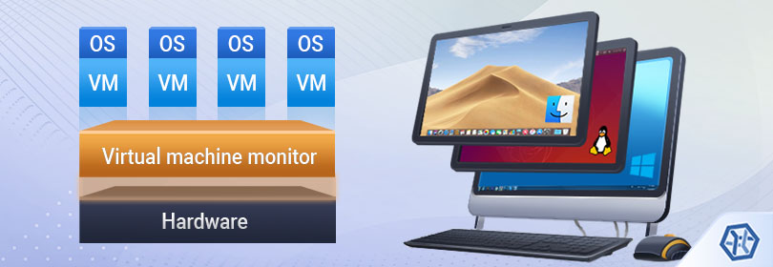
VIRTUAL MACHINE
IN 1997 VM VARE COMPANY DEVELPED A CONCEPT OF VIRTUAL MACHINE .
A VIRTUAL MACHINE IS A BEGINNER APPROACH , FOR RUNNING MULTIPLE OPERATING SYSTEMS AND APPLICATIONS ON A SINGLE HOST MACHINE.

Slide 5
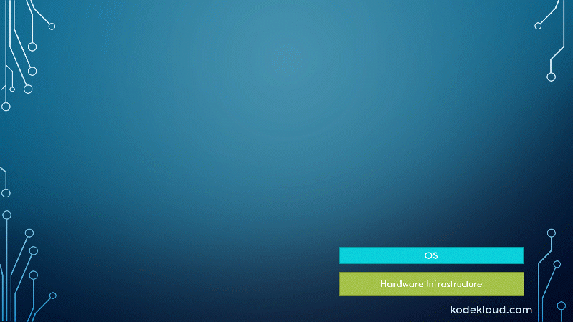
Virtualization vs Containerization
Each VM runs its own Operating system | All Container Share same OS of the host system
Boot up time required it is in limit | Container Initiate in second .
It is Not version controlled. | Docker containers work just like GIT , allowing you to a commit changes to your Docker images version control them.
.

Slide 6
DIFFERENT VENDORS
Tech Companies Embracing Container Technology
DOCKER
KUBERNETS
AMAZON WEB SERVICES
DIGITAL OCEAN
FUZE and many more

Slide 7
DOCKER
Docker is an open-source platform that enables you to build, package, and distribute applications using lightweight, self-contained units called containers.
Containers are like little virtual machines that bundle everything an application needs to run consistently across different environments.
Docker offers several advantages:
Portability:.
Efficiency:
Reproducibility:

Slide 8
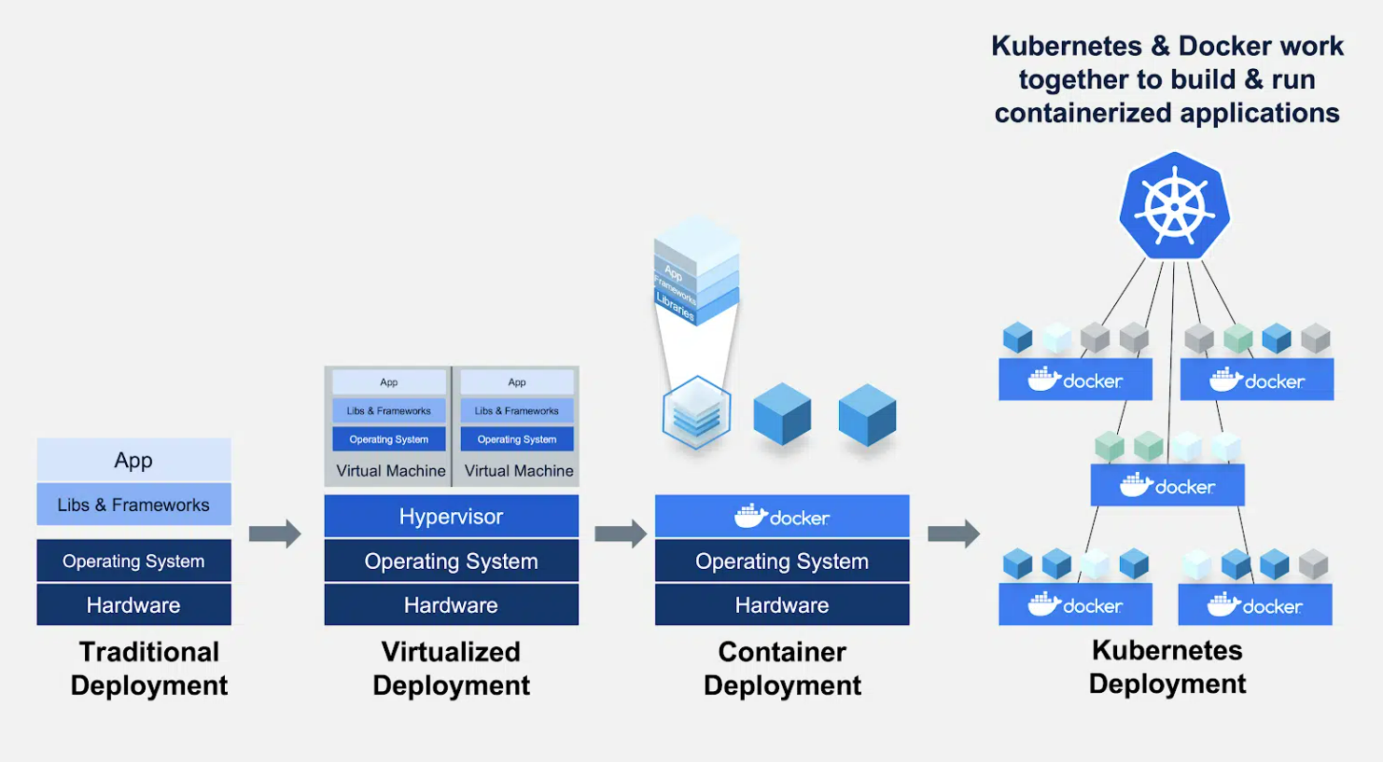

Slide 9
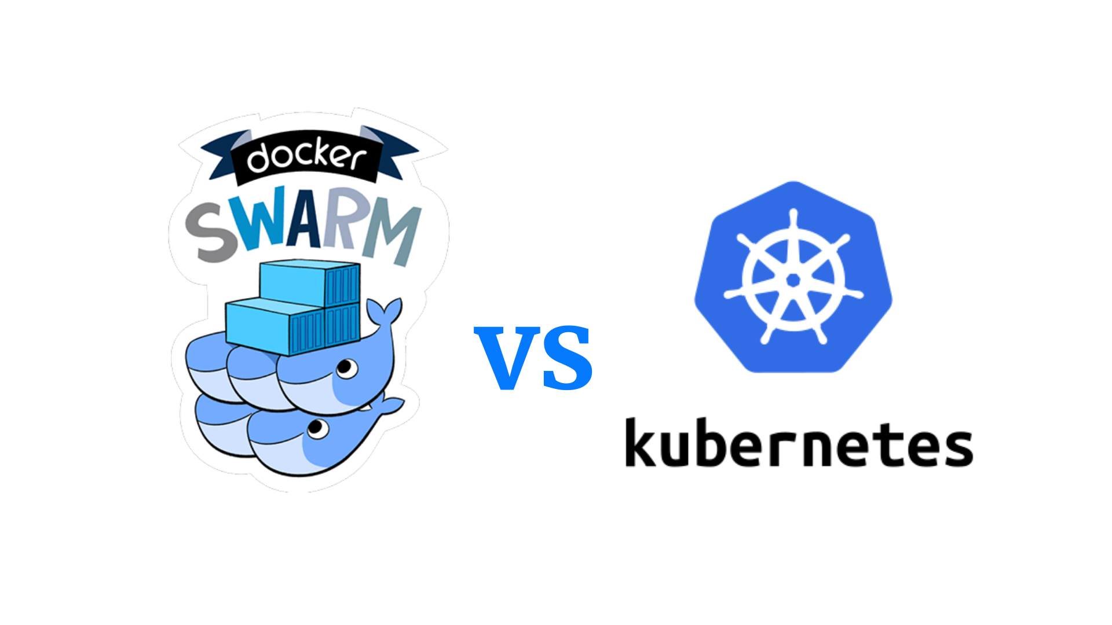
We can solve this issue by Containerization

Slide 10
History of Kubernetes
AWS Offer Cloud
GOOGLE ‘s orchestration
Borg
Omega
Google – made K8s Open Source in 2014
Donated to CNCF

Slide 11
What is Kubernetes?
An open-source and more than container orchestration system
For automating software deployment, scaling, and management
Originally developed by Google
helps us to manage applications
made up of hundreds or maybe thousands of containers
helps us to manage them in different environments

Slide 12
Architecture of Kubernetes

Slide 13


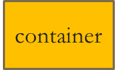
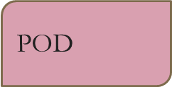

User
Cluster
Control Plane
Worker Node
etcd
Key-value
Kube-proxy
POD
container
Controller manager
API SERVER
Kublet
POD
Action
Scheduler
Container
Engine
Developer

Slide 14
User
Cluster
Control Plane
Worker Node
etcd
Key-value
Kube-proxy
POD
container
Controller manager
API SERVER
Kublet
POD
Action
Scheduler
Container
Engine
Kubectl(CLI)
Developer

Slide 15
Kubernetes Benefits
Automated Scheduling
Self Healing Capabilities
Automated rollouts & rollback
Horizontal Scaling & Load Balancing

Slide 16
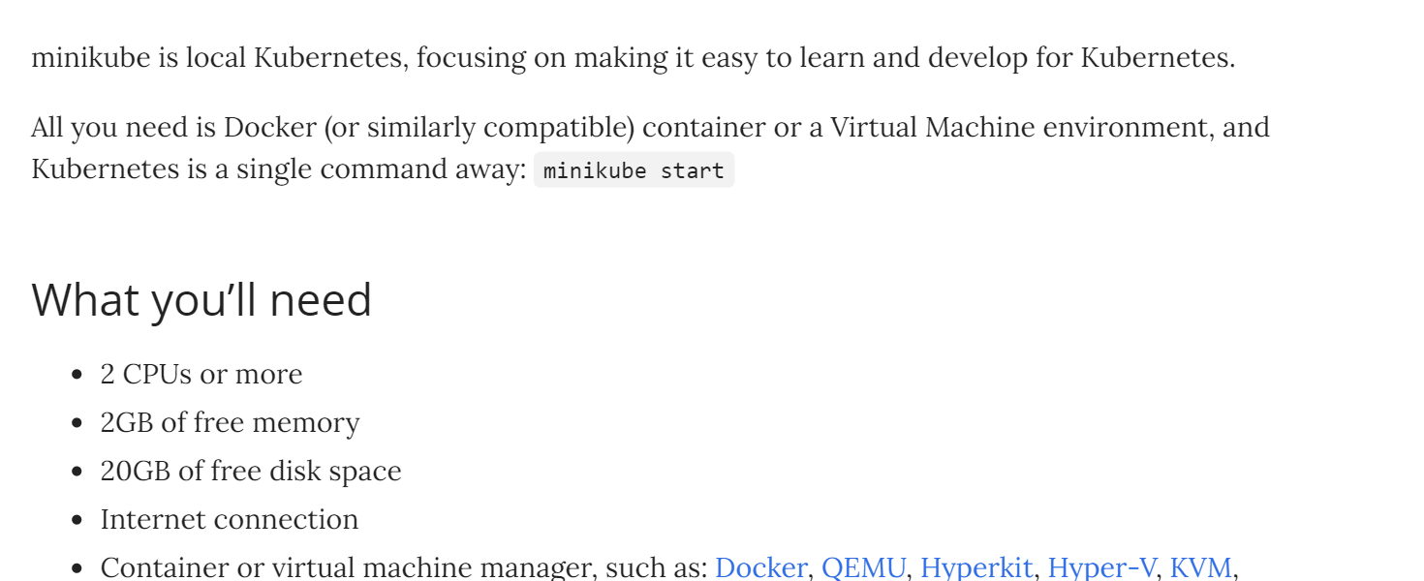
What will you need ?

Slide 17

What we want to deploy ? We can deploy html web site to the Minikube dashboard and docker.

Slide 18
STEPS
Install Minikube , kubectl and docker ☑
Start Minikube using command ☑
Create docker image and pods ☑
Deploy on docker site ☑
Login into docker ☑
Push docker image ☑
Deploy on Minikube dashboard localhost

Slide 19
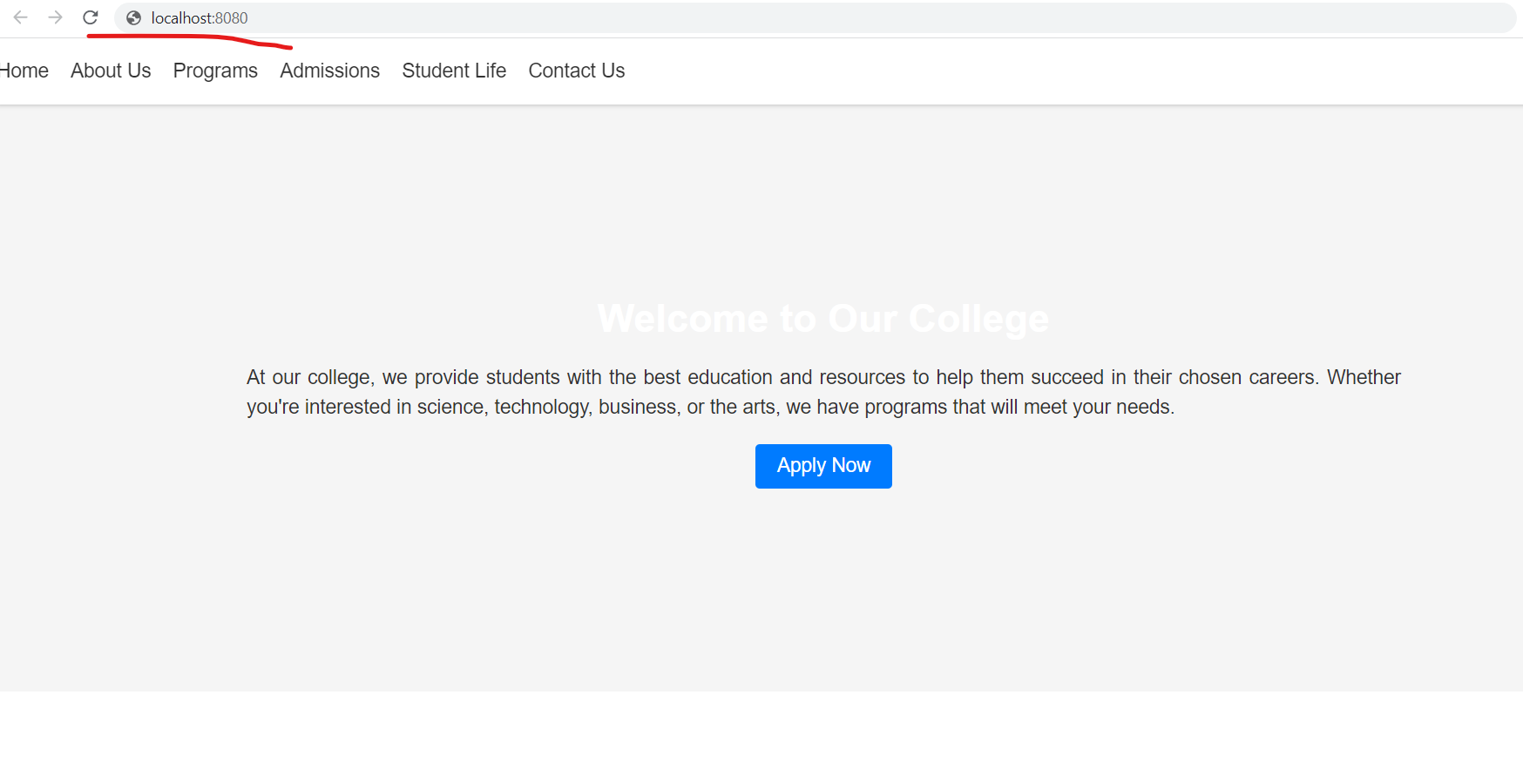
4)Finally run on localhost

Slide 20

Thank You!

